Slide 1
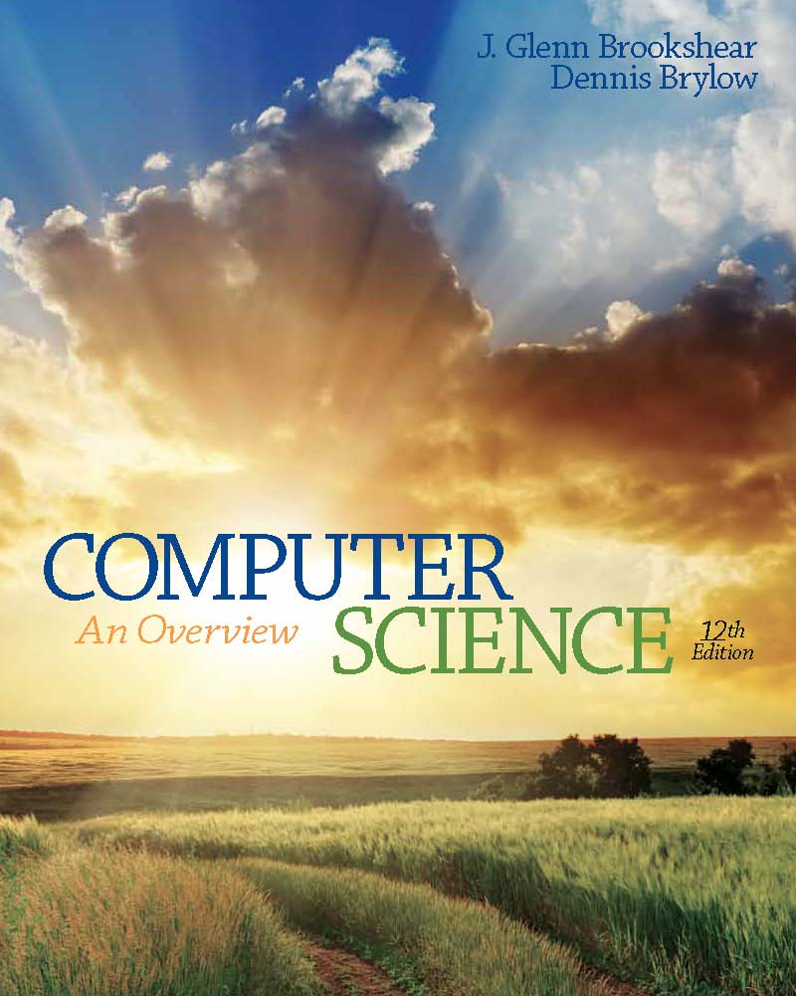
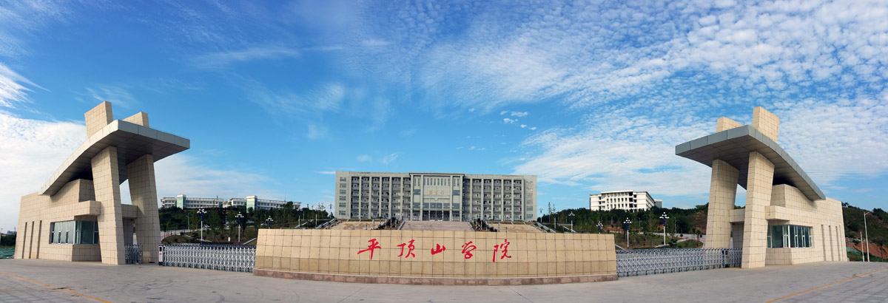
Computer Science: An Overview
Chapter 0
Twelfth Edition
Introduction
Yu Yang
School of Computer Science,
Pingdingshan University,
yangyu@pdsu.edu.cn
Notes:
If this PowerPoint presentation contains mathematical equations, you may need to check that your computer has the following installed:
1) MathType Plugin
2) Math Player (free versions available)
3) NVDA Reader (free versions available)

Slide 2
Learning Objectives（学习目标）
0.1 The Role of Algorithms (算法的角色)
0.2 The History of Computing
0.3 An Outline of Our Study （大纲）
0.4 The Overarching（首要） Themes of Computer Science
Algorithms
Abstraction
Creativity
Data
Programming
Internet
Impact

Slide 3
Terminology（术语）
Algorithm: A set of steps that defines how a task is performed
Program: A representation of an algorithm
Programming: The process of developing a program
Software: Programs and algorithms
Hardware: Equipment / Machinery

Slide 4
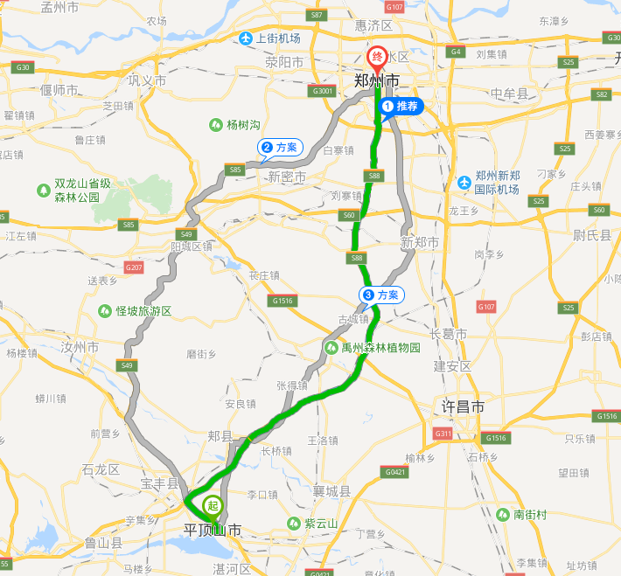
History of Algorithms
The study of algorithms was originally a subject in mathematics.
Early examples of algorithms
Long division algorithm
Euclidean Algorithm
Gödel‘s（哥德尔） Incompleteness Theorem: Some problems cannot be solved by algorithms.
Algorithms are not omnipotent（万能的）

Slide 5
The Euclidean Algorithm
Description: This algorithm assumes that its input consists of two positive integers and proceeds to compute the greatest common divisor of these two values.
Procedure:
Step 1. Assign M and N the value of the larger and smaller of the two input values, respectively.
Step 2. Divide M by N, and call the remainder R.
Step 3. If R is not 0, then assign M the value of N, assign N the value of R, and return to step 2; otherwise, the greatest common divisor is the value currently assigned to N.

Slide 6
History of Computing
Early computing devices
Abacus（算盘）: positions of beads represent numbers
Gear-based（齿轮） machines (1600s-1800s)
Positions of gears represent numbers
Blaise Pascal, Wilhelm Leibniz, Charles Babbage
发明家

Slide 7
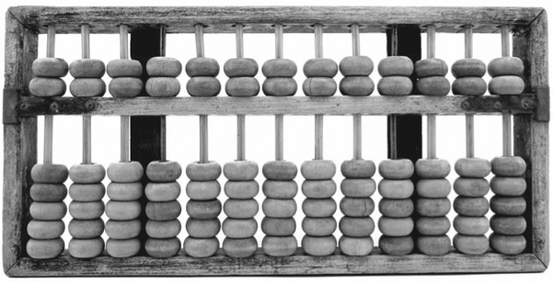
Figure 0.1 Chinese Wooden Abacus

Slide 8
Early Data Storage
Punched（穿孔） cards
First used in Jacquard（雅卡尔） Loom（织布机） (1801) to store patterns for weaving cloth
Storage of programs in Babbage’s Analytical Engine
Popular through the 1970’s
Gear positions（依赖齿轮位置）

Slide 9
Early Computers
Based on mechanical（机械式） relays（继电器）
1940: Stibitz at Bell Laboratories
1944: Mark I: Howard Aiken and I B M at Harvard
Based on vacuum tubes（真空管）
1937-1941: Atanasoff-Berry at Iowa State
1940s: Colossus（巨人）: secret German code-breaker
1940s: E N I A C: Mauchly & Eckert at U. of Penn.

Slide 10
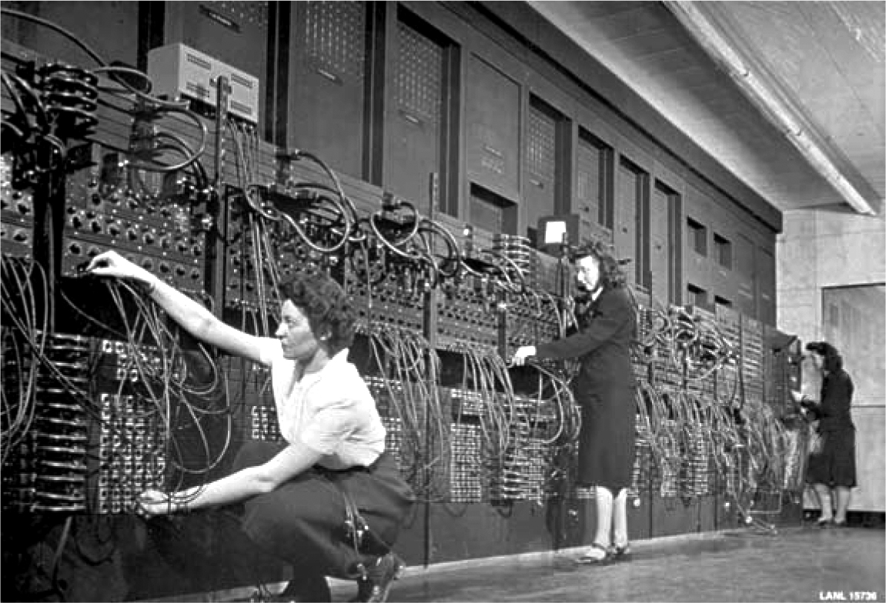
Figure 0.2 The E N I A C Computer

Slide 11
Personal Computers
First used by hobbyists
I B M introduced the P C in 1981.
Accepted by business
Became the standard hardware design for most desktop computers
Most P C s use software from Microsoft

Slide 12


Into the Millennium（千年）
Internet revolutionized communications
World Wide Web
Search Engines (Google, Yahoo, and Microsoft，baidu 2000)
Miniaturization of computing machines
Embedded (G P S, in automobile engines 汽车发动机)
Smartphones

Slide 13
Outline of Our Study (1 of 2) 大纲
Chapter 1: Data Storage
Chapter 2: Data Manipulation
Chapter 3: Operating Systems
Chapter 4: Networks and the Internet
Chapter 5: Algorithms
Chapter 6: Programming Languages

Slide 14
Outline of Our Study (2 of 2)
Chapter 7: Software Engineering
Chapter 8: Data Abstractions（抽象）
Chapter 9: Database Systems
Chapter 10: Computer Graphics
Chapter 11: Artificial Intelligence
Chapter 12: Theory of Computation

Slide 15
The Overarching（首要） Themes of Computer Science
Computing technology effects:
Governments, economics, scientific research, role of data, communication, …
Seven “Big Ideas” that unite computer science(七大思想）
Algorithms, Abstraction, Creativity, Data, Programing, Internet and Impact

Slide 16
Algorithms
The science of algorithms
Draws（借鉴） from other subjects, including
Mathematics
Engineering
Psychology
Business Administration（商业管理）

Slide 17
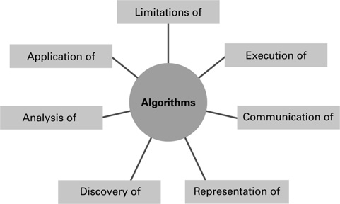
Figure 0.3 The Central Role of Algorithms in Computer Science

Slide 18
Given the Central Role of Algorithms (1 of 2)
Which problems can be solved by algorithmic processes?
How can algorithm discovery be made easier?
How can techniques of representing（表示） and communicating（传达） algorithms be improved?
How can characteristics of different algorithms be analyzed and compared?

Slide 19
Given the Central Role of Algorithms (2 of 2)
How can algorithms be used to manipulate information?
How can algorithms be applied to produce intelligent behavior?
How does the application of algorithms affect society?

Slide 20
Abstraction（抽象）
Abstraction: The distinction between the external properties of an entity and the details of the entity’s internal composition（构成）
Abstract tool: A “component” that can be used without concern for the component’s internal properties

Slide 21
Creativity（创新）
Computer science is inherently（固有地） creative
Discovering and applying algorithms is a human activity
Extends forms of expression in many ways（扩展表示形式）
Creating large software systems is like conceiving（构想） a grand new sculpture

Slide 22
Data
Computers can represent（表达） any information
That can be discretized（离散化） and digitized
Algorithms process（处理） and transform data
Massive storage capacities（海量存贮）
High speed networks
数据驱动着发现

Slide 23
Questions About Data
How do computers store data about common digital artifacts?（常见的数字人工制品）
Numbers, text, images, sounds, and video
How do computers approximate（近似估计） data about analog（模拟） artifacts in the real world?
How do computers detect and prevent errors in data?
What are the ramifications （分支后果）of an ever-growing(日益增长) and interconnected universe of digital data?

Slide 24
Programming（程序设计）
Programming is broadly referred to as:
Translating human intentions into executable algorithms
Computer hardware is capable of only simple algorithmic steps（计算机硬件只能执行简单的步骤）
Abstractions in a programming language allow humans to reason and encode solutions（编码解决方案） to complex problems（复杂问题）

Slide 25
Questions About Programming
How are programs built?（构建）
What kind of errors can occur in programs?
How are errors in programs found and repaired?
What are the effects of errors in modern programs?
How are programs documented（文档化） and evaluated?（评估）

Slide 26
Internet
Profound impact（深远的影响） in the way information is:
Stored
Retrieved（检索）
Shared （检索）
Privacy（隐私）
Security（安全）

Slide 27
Impact (1 of 2)
Social, ethical（伦理道德）, legal（法律） impacts including:
Security concerns（安全问题）
Issues of software ownership（所有权） and liabilities（责任，债务）
Social impact of database technology
Consequences of artificial intelligence

Slide 28
Impact (2 of 2)
No “Correct” answers, instead（相反地） increase awareness of:
Various stakeholders（利益相关人）
Alternatives（多种替代方案）
Short term and long term consequences
Character-based ethics（性格伦理—柏拉图和亚里士多德）
“Good Behavior” is a consequence of “Good Character”（好行为是良好性格的自然结果）

Slide 29
Thank you all!

